Slide 1
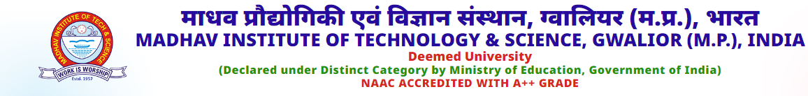
Olympic Performance Trends and Medal Analysis Using Power BI
Submitted By :-
Kartika Kannojiya (0901MC211034)
Submitted To :-
Dr. S. K. Bhardwaj

Slide 2
What Is Business Intelligence
Business Intelligence (BI) involves the use of processes, tools, and technologies to gather, integrate, analyze, and visualize data for better decision-making. It centralizes data from various sources, performs in-depth analysis to uncover trends and insights, and presents these findings through visualizations like dashboards and reports.
BI tools like Power BI enable users to create self-service analyses, helping organizations optimize operations, reduce costs, and gain a competitive edge.

Slide 3
What is Microsoft Power BI
Microsoft Power BI is a business analytics tool that helps users visualize data, create interactive dashboards, and generate reports for data-driven decision-making.
It connects to various data sources, supports real-time analytics, and allows users to clean, transform, and model data easily. With AI-powered features, mobile access, and seamless integration with other Microsoft products like Excel and Azure, Power BI enables self-service analytics and secure sharing of insights, fostering collaboration and improving business performance.

Slide 4
Why we use Power BI?
Visualize Data: Create interactive, easy-to-understand reports and dashboards.
Gain Insights: Make data-driven decisions with real-time analytics.
Integrate Data: Connect to various data sources in one platform.
User-Friendly: Simple interface suitable for all users.

Slide 5
Components Power BI?
Power BI Desktop: Create and design reports and dashboards.
Power BI Service: Cloud platform for sharing and collaboration.
Power BI Mobile: Access reports on mobile devices.
Power BI Gateway: Connects on-premises data to Power BI for real-time access.
Power Query: Tool for data connection and transformation.

Slide 6
What is Power Query
Power Query is a data transformation and data preparation engine.
Power Query is an ETL tool [ Extract Transfer Load ].
A Power Query helps you to clean , Summarize and filter data in a table.
Perform Calculations.

Slide 7
Advantage and Disadvantage of Power BI
Advantages
User-friendly and intuitive interface.
Seamless integration with Microsoft products.
Supports a wide range of data sources.
Offers custom and built-in visualizations.
Disadvantages
Free version has limitations on data and features.
Performance issues with very large datasets.
Complex licensing and pricing structure.
Dependence on internet connectivity.

Slide 8
Features Of Power BI
Interactive Dashboards: Create dynamic, visually appealing reports and dashboards.
Data Connectivity: Connects to multiple data sources, including Excel, databases, and cloud services.
Data Transformation: Provides tools for cleaning, shaping, and modeling data.
AI Integration: Offers AI features like natural language queries and machine learning models.
Collaboration and Sharing: Securely share reports and collaborate using Power BI Service.
Microsoft Integration: Integrates seamlessly with Excel, Azure, Teams, and other Microsoft tools.

Slide 9
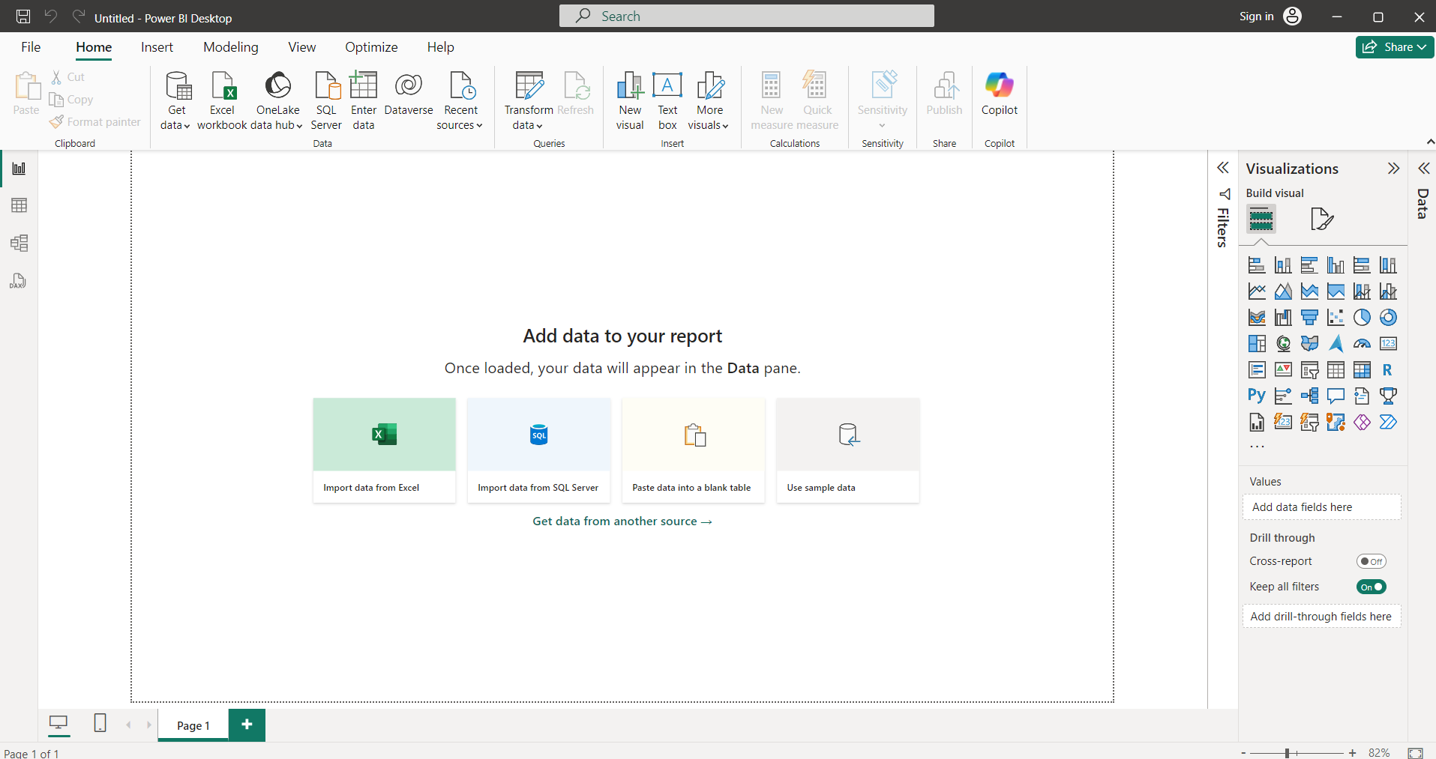
Introduction to Power Bi Interface

Slide 10
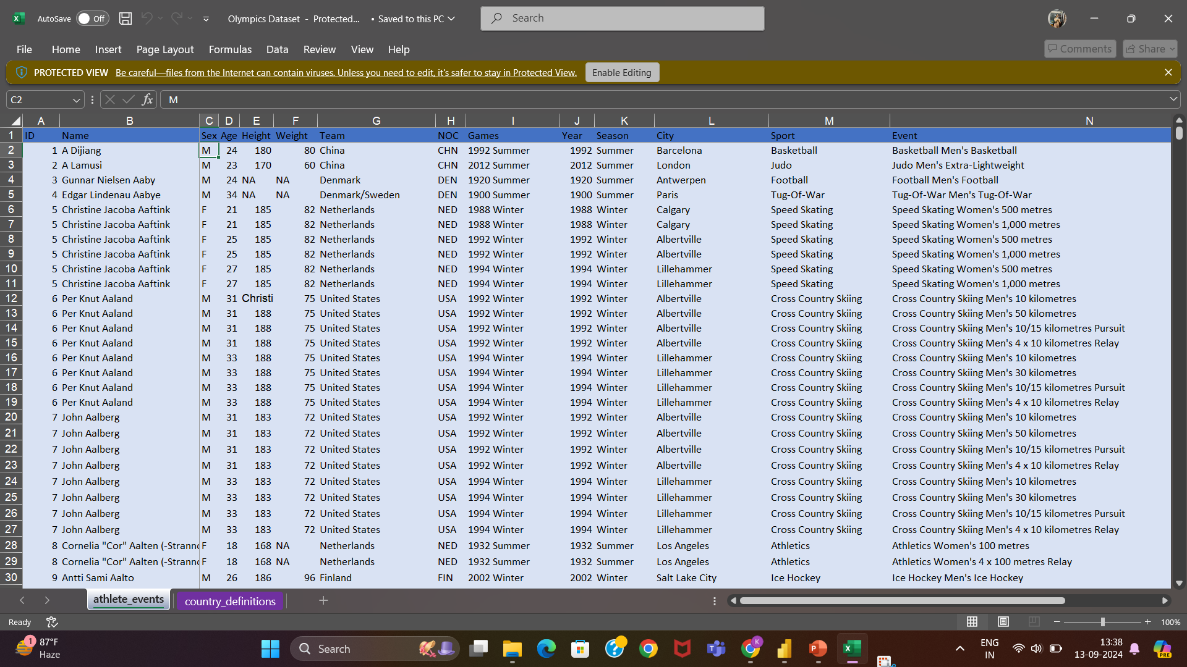

Slide 11
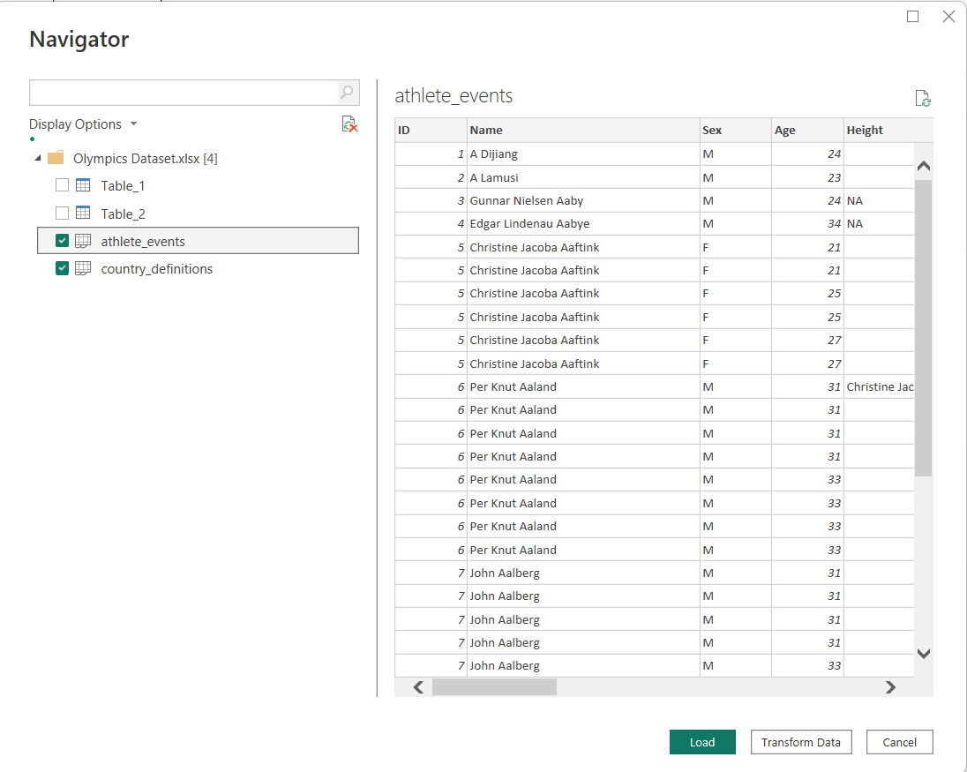

Slide 12
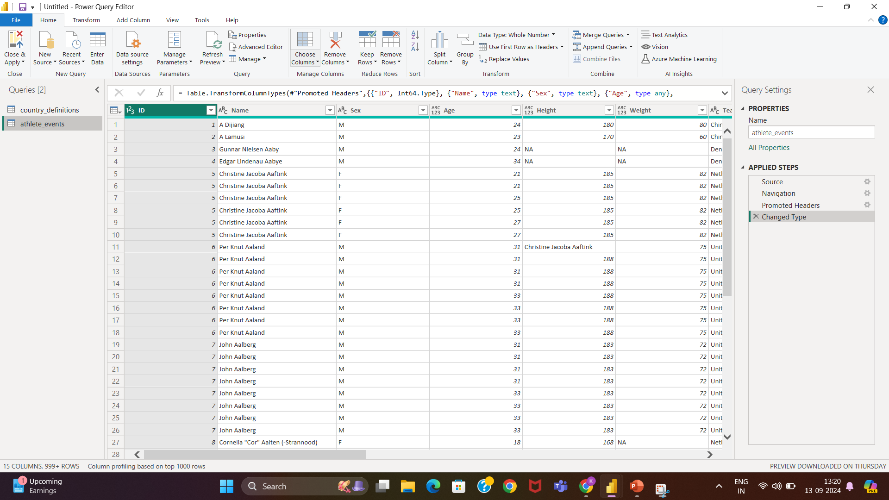

Slide 13
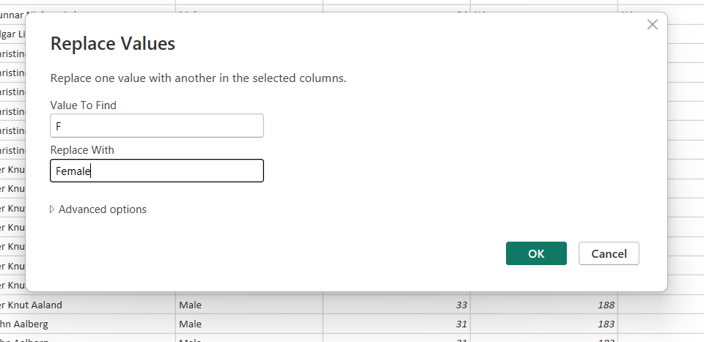
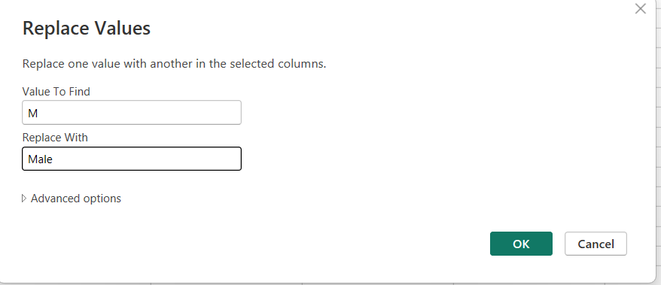

Slide 14
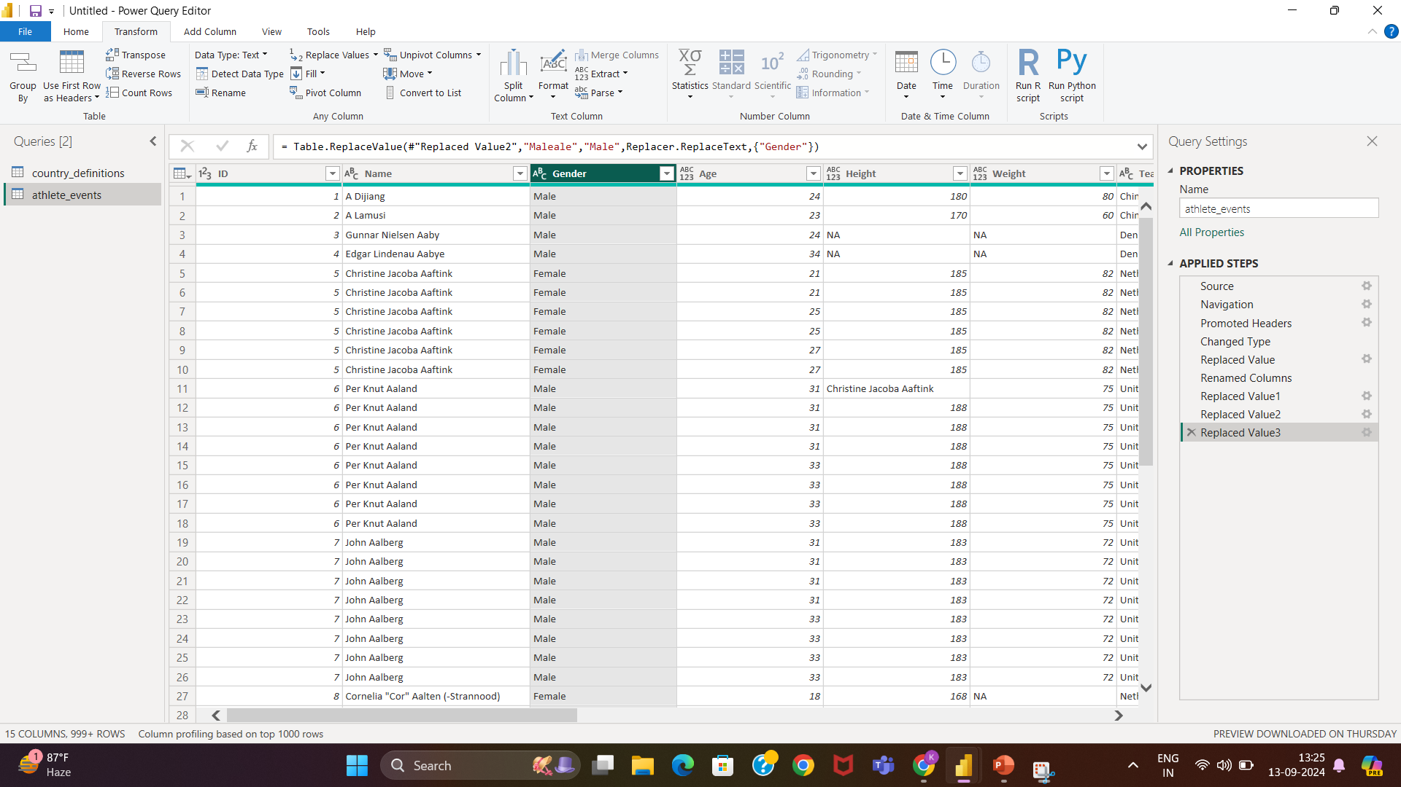

Slide 15
Analysis of Olympic Dashboard

Slide 16
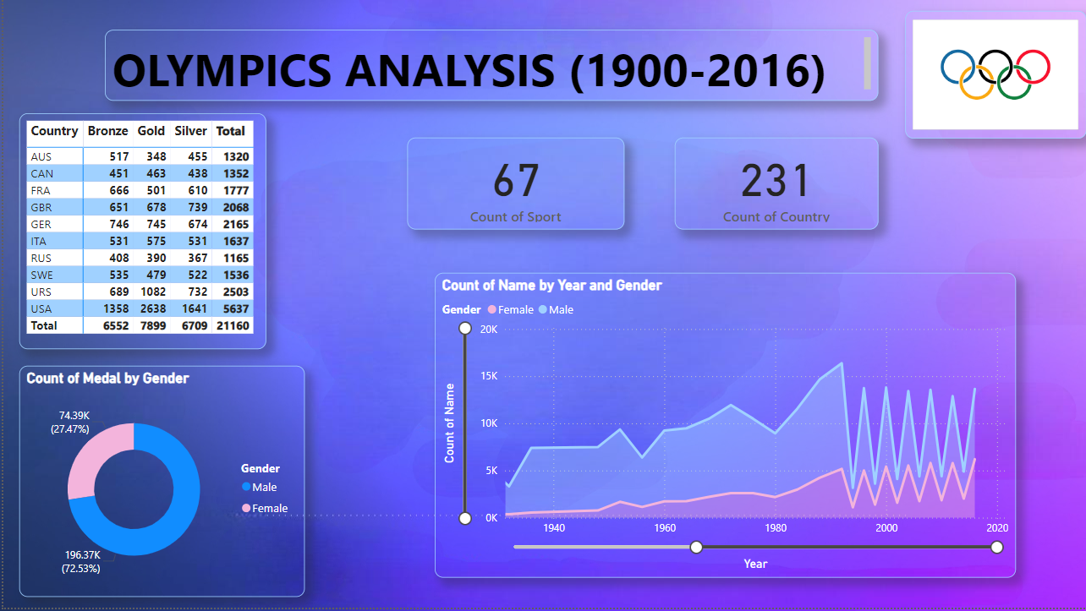

Slide 17
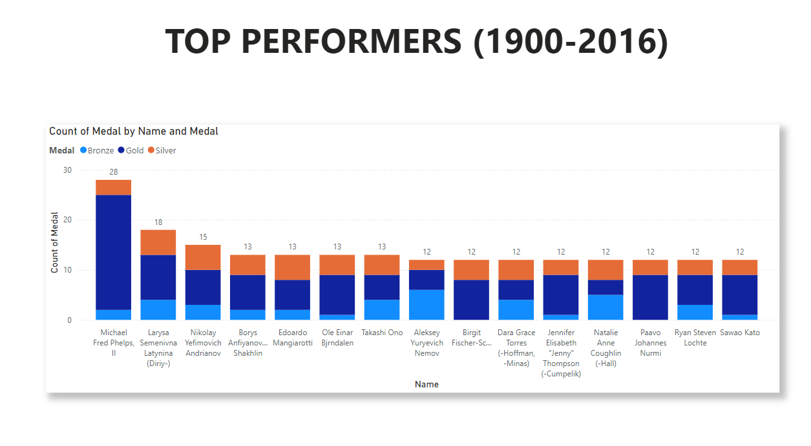

Slide 18
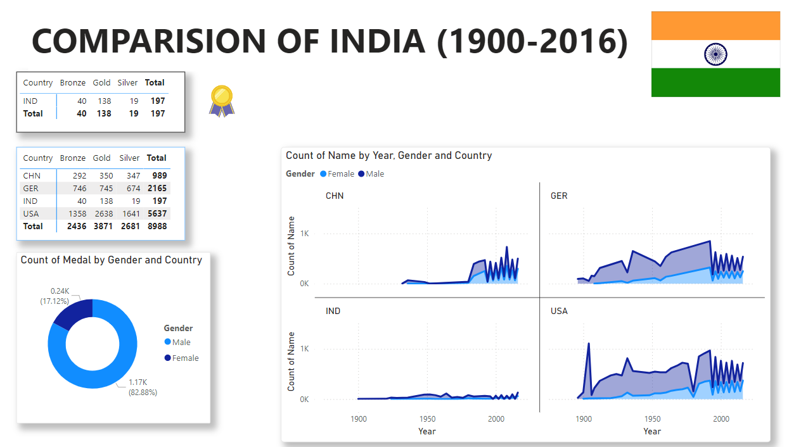

Slide 19
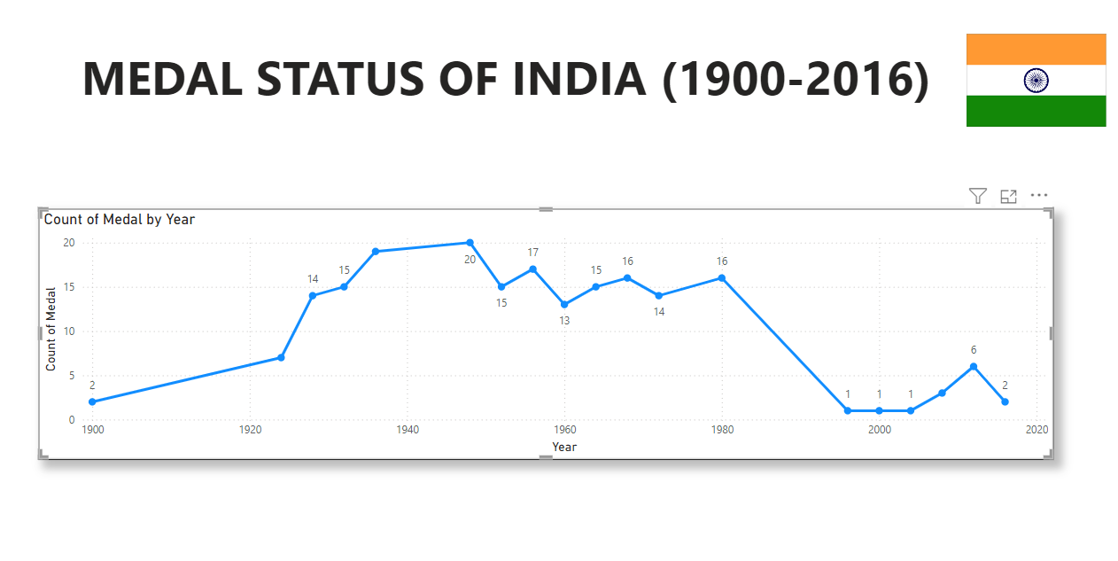

Slide 20
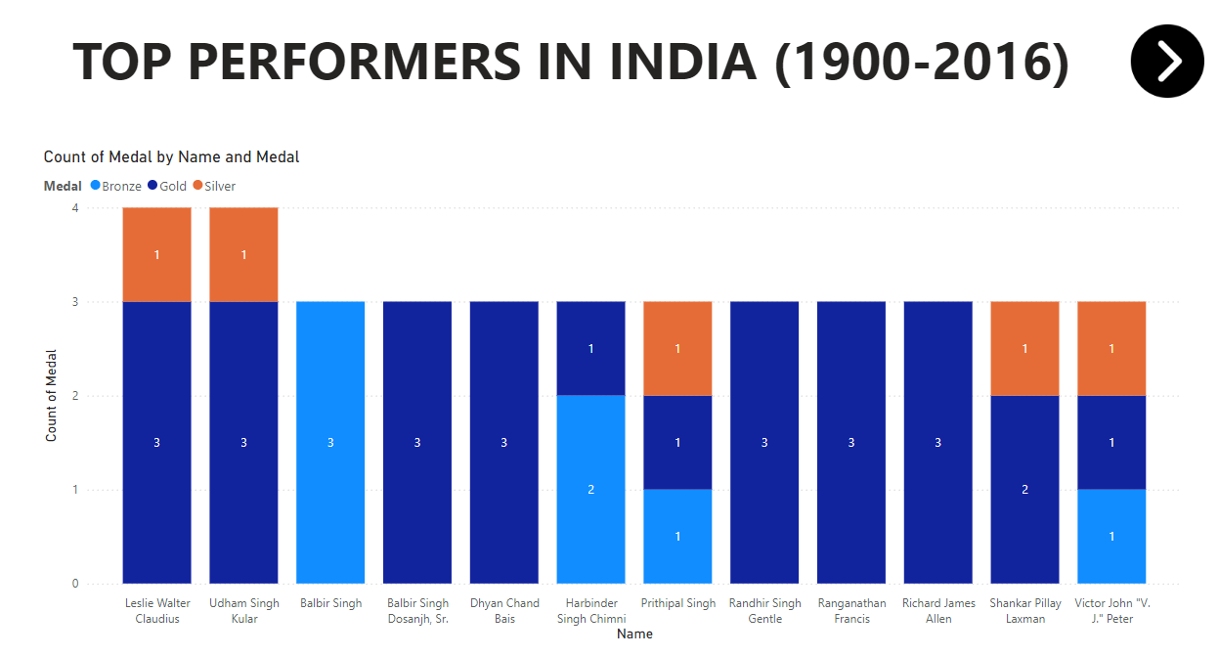

Slide 21
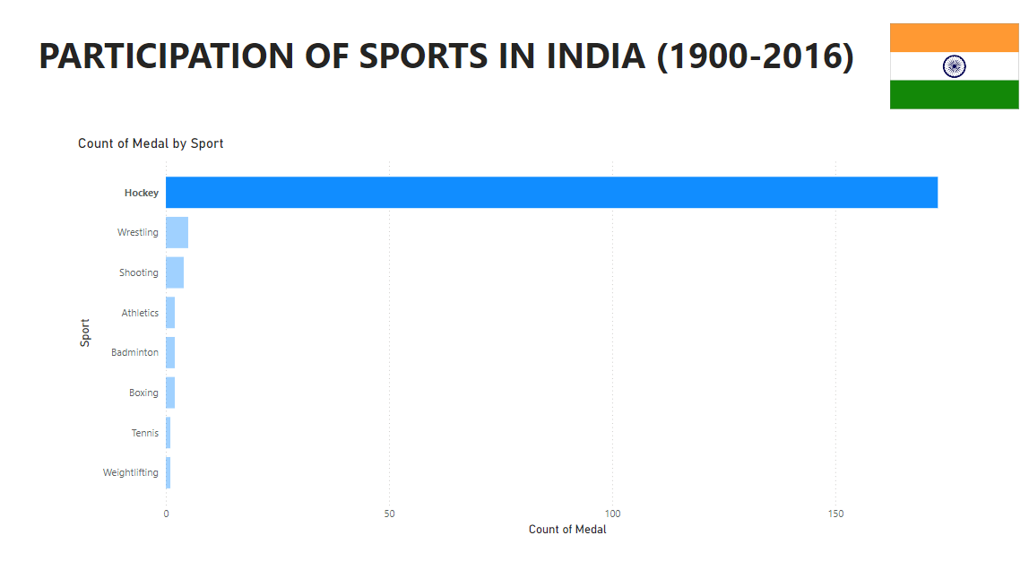

Slide 22
Male and Female participation in the Olympics:
MALE
1896 Start: The first modern Olympics were exclusively male with no events for women.
Sport Dominance: Men participated in all sports from the start, including combat sports like boxing and wrestling.
Higher Participation: Historically, male athletes outnumbered female athletes, especially in early years.
More Events: Men had more events and categories in sports like athletics, swimming, and cycling.
Media Focus: Male athletes traditionally received more media coverage and sponsorship deals.
FEMALE
1900 Debut: Women first competed in the 1900 Paris Olympics in limited sports like tennis and golf.
Gradual Expansion: Women's events grew over time, with key milestones like athletics in 1928, basketball in 1976, and boxing in 2012.
Rising Participation: Female representation rose from 2% in 1900 to nearly 49% in the 2020 Tokyo Olympics.
More Events: Women's events have significantly increased, with many sports now having equal events for men and women.
Gender Equality: The IOC promotes gender parity, aiming for 50-50 participation by the 2024 Paris Olympics and introducing mixed-gender events.

Slide 23
Comparison of INDIA’s performance over time
1990s: India’s Olympic participation was relatively low in medal tally (1 medal in 1996), with limited infrastructure and support.
2000s: Gradual improvement (especially in shooting, wrestling, and boxing), culminating in 3 medals in 2008.
2010s: Major leap forward with 6 medals in London 2012, signaling India’s growing presence in global sports.
2020s: Tokyo 2020 marked India’s best-ever performance with 7 medals, including a historic gold in athletics.

Slide 24
Key Milestones of Women in Olympics:
1928: Women competed in track and field events for the first time at the Amsterdam Games.
1976: Women’s basketball was introduced.
1984: Women’s marathon and shooting events were introduced.
2012: London became the first Olympics where all participating countries had at least one female athlete.
2020: The Tokyo Olympics had the highest level of female participation, nearly achieving gender parity with 48.8% women.

Slide 25
India's Contribution to Women's Participation
In the context of India, women athletes have become prominent contributors to the country’s Olympic successes in recent years. Significant milestones include:
Karnam Malleswari: The first Indian woman to win an Olympic medal (bronze in weightlifting, Sydney 2000).
Mary Kom: A boxing legend and a bronze medalist at the 2012 London Olympics, inspiring a new generation of Indian women boxers.
P. V. Sindhu: India’s first female silver medalist in badminton (Rio 2016), followed by a bronze in Tokyo 2020.
Sakshi Malik: India’s first female wrestler to win an Olympic medal (bronze, Rio 2016).
Mirabai Chanu: Weightlifting silver medalist at Tokyo 2020.
Manu Bhaker : First Indian woman to win a shooting medal at the Olympics.

Slide 26
India at the 2024 Summer Olympics
At the 2024 Summer Olympics in Paris, India had a contingent of 117 athletes, with 70 men and 47 women competing across 16 sports.
Manu Bhaker was notable as the first Indian woman to win a shooting medal at the Olympics, earning two bronze medals, one individually in the 10m air pistol and another in the mixed team event.
Neeraj Chopra, India’s javelin throw sensation, earned a silver medal, becoming the country’s most successful individual Olympian.
The Indian men's hockey team won a bronze medal, repeating their podium finish from the Tokyo 2020 Olympics.
India's medal tally in Paris 2024 demonstrated growing success in sports like shooting, wrestling, and athletics, though the contingent also faced near-misses, with several athletes finishing just shy of podium positions.

Slide 27
Recent Gender Equality Initiatives
The International Olympic Committee (IOC) has made significant strides to promote gender equality:
Mixed-Gender Events: The introduction of mixed-gender events in several sports (such as relays in swimming, athletics, triathlon, and shooting) allows men and women to compete together. This has helped balance participation and bring a new dimension to Olympic sports.
Quota Systems: The IOC has enforced rules to ensure that sports federations achieve gender parity in the number of events offered to men and women. For instance, boxing now has the same number of male and female weight categories.
Equal Prize Money: Across most sports in the Olympics, prize money and recognition are now equal for male and female athletes, a significant improvement from earlier times when men were often paid more for their victories.

Slide 28
India’s Olympic medals count by sport from 1900 to 2016:
1. Field Hockey
Total Medals: 11 (8 Gold, 1 Silver, 2 Bronze)
India dominated men's field hockey from 1928 to 1980, winning 8 gold medals, 1 silver (1960), and 2 bronze (1968, 1972).
2. Wrestling
Total Medals: 5 (2 Silver, 3 Bronze)
Silver: Sushil Kumar (2012), Ravi Kumar Dahiya (2016)
Bronze: KD Jadhav (1952), Sushil Kumar (2008), Yogeshwar Dutt (2012)
3. Shooting
Total Medals: 4 (1 Gold, 2 Silver, 1 Bronze)
Gold: Abhinav Bindra (2008)
Silver: Rajyavardhan Singh Rathore (2004), Vijay Kumar (2012)
Bronze: Gagan Narang (2012)
4. Boxing
Total Medals: 2 (1 Silver, 1 Bronze)
Silver: Vijender Singh (2008)
Bronze: Mary Kom (2012)

Slide 29
5. Badminton
Total Medals: 2 (1 Silver, 1 Bronze)
Silver: P.V. Sindhu (2016)
Bronze: Saina Nehwal (2012)
6. Weightlifting
Total Medals: 1 (1 Bronze)
Bronze: Karnam Malleswari (2000)
7. Athletics
Total Medals: 0 (Best finish before 2016: 4th by Milkha Singh in 1960)
8. Tennis
Total Medals: 1 (1 Bronze)
Bronze: Leander Paes (1996)
9. Shooting (pre-2000)
Total Medals: 0 (Before 2000, India did not win any shooting medals)
10. Overall Tally (1900–2016)
Total Medals: 28 (9 Gold, 7 Silver, 12 Bronze)

Slide 30
Thank You

